Slide 1



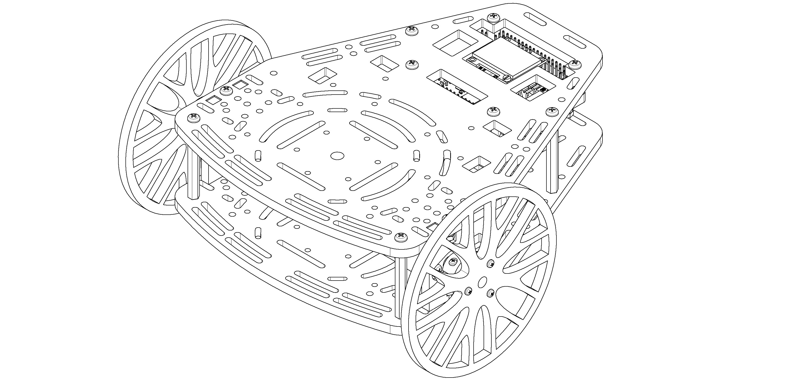
ROS Recap
From zero to a functional communication scheme

Slide 2
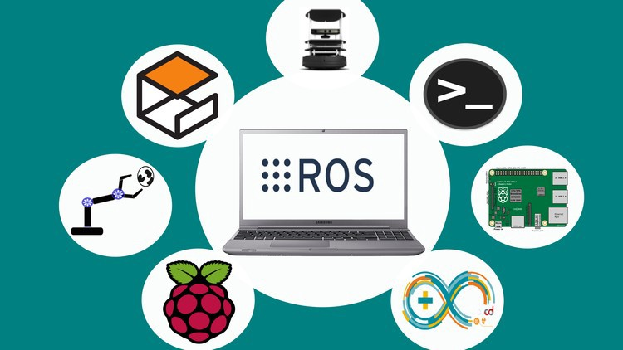
ROS basics What is ROS ?
“ROS is an open-source framework that helps researchers and developers build and reuse code between robotics applications”

Slide 3
ROS basics The conceptual idea behind ROS
University
Teacher 1
Teacher 2
/ROS
/Control
/ROS
Student B
/Weekend
/Control
Student C
Student A
/Party
Student D

Slide 4
ROS basics What is the information delivered?
Any class has a certain format, which both the teacher and the student know off and is expected to be followed.
Between two friends you are not expecting a power point presentation but some plain text.
Publishers
Data types
Subscribers
Teacher
/ROS
Presentation and a
practical explanation
Students
Student
/Weekend
Plain text and memes
Student

Slide 5
ROS Architecture ROS Master
Brain of ROS -> Process manager that enables the communication between different agents in the network.
Allows communication between different computers or robots by means of a Server – Client architecture
ROS Master
User
Node 2
TCP IP Com
User
Node 1
Robot
Node
ROS Serial
Micro.
Node

Slide 6
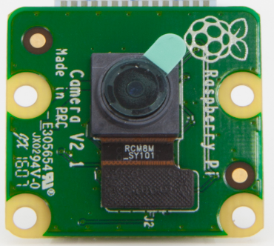
ROS Architecture nodes and topics
Piece of software that acts as an element in the network.
It is in charge of executing a part of the code and can be programmed in Cpp, Python or Lisp.
Each topic has a unique msg type.
Hardware
Node
Node
Obstacle detection
node
Get
data
/Image
Node
Cables
White line detection
node

Slide 7
ROS Architecture Services and actions
While topics are one way communication, services and actions allow feedback and prevent unnecessary load in the network.
Services follow a question-answer structure, while actions are designed to execute a task and give feedback during the process.
Control Node
User Input Node
Can you send me a path ?
Move to point A
Updated path
Updates:
Current pose
Success !
Planning Node
Control Node
Service
Action

Slide 8



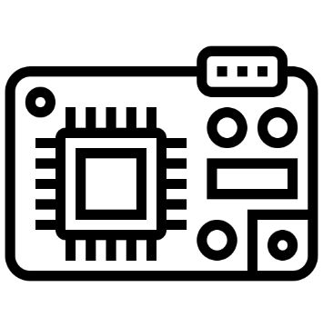
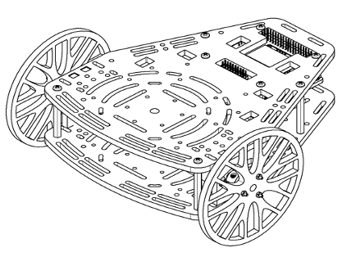
ROS Architecture A practical example
PC

Slide 9


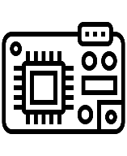
ROS Architecture Overview
Ros Master
Micro
User
Node
Sensors
Node
Control
Node
Actuators
Node
Physical System
ROS Implementation

Slide 10
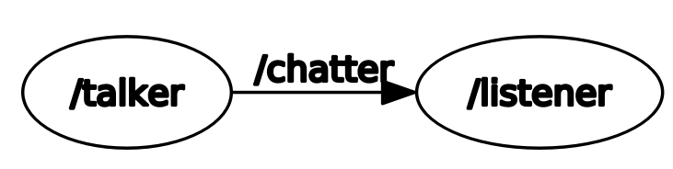
ROS Code Talker and listener framework
Simplest communication scheme.

Slide 11
ROS Code Talker
#!/usr/bin/env python import rospy from std_msgs.msg import String
if __name__ == '__main__': pub = rospy.Publisher("chatter", String, queue_size=10) rospy.init_node("talker") rate = rospy.Rate(10)
while not rospy.is_shutdown(): hello_str = "hello world %s" % rospy.get_time() pub.publish(hello_str)
rate.sleep()
Setup environment and import libraries
Create variables and setup node
Publish message
Wait to run again
Terminal Commands
roscore
rosrun basic_comms talker.py
rostopic echo /chatter

Slide 12
ROS Code Listener
#!/usr/bin/env python import rospy from std_msgs.msg import String
def callback(msg): rospy.loginfo("I heard %s", msg.data)
if __name__ == '__main__': rospy.init_node('listener') rospy.Subscriber("chatter", String, callback)
rospy.spin()
Setup environment and import libraries
Define Callback
Create variables and initialise node
Continuously check for new messages
Terminal Commands
roscore
rosrun basic_comms listener.py
rostopic pub /chatter <tab complete>

Slide 13
ROS Tools ROS Terminal tools
roscore
Must be executed before working with ros
Handles the correct functionality of the network
rostopic
Contains useful tools related with topics
rostopic echo [topic name]
rostopic list
rostopic hz [topic name]
rosrun
Executes a given node
rosrun [package] [node name]
rosnode
Contains useful tools related with nodes
rosnode list
rostopic info [node]

Slide 14
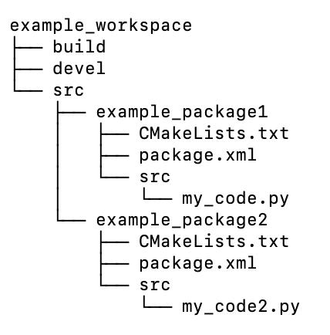
ROS Tools ROS File structure
ROS projects are organized using workspaces, which are a collection of grouped codes called packages.
Instructions for the compiler need to be allocated in .cmake and package files
Package files are exportable between projects
Configuration files used to stablish code dependencies
Code that we will execute
Catkin_make will generate ‘src’ and ‘devel’ for you when compiling the workspace

Slide 15
ROS Tools ROS Compilation tools
ROS requires to compile each package, generating dependencies related with other packages, external libraries or custom messages, services and actions.
The preferred compilation tool is known as catkin and uses two separated files, package.xml and CMakeLists.txt.
A useful command to create packages is:
catkin_create_pkg [name] [list of dependencies]
Which generates an empty package and templates of both CMakeLists and package files.
More information about the syntaxis of this files can be found In http://wiki.ros.org/ROS/Tutorials/CreatingPackage
Projects are compiled with the instruction catkin_make and the instruction source [project]/devel/setup.bash needs to be executed to load the changes.

Slide 16
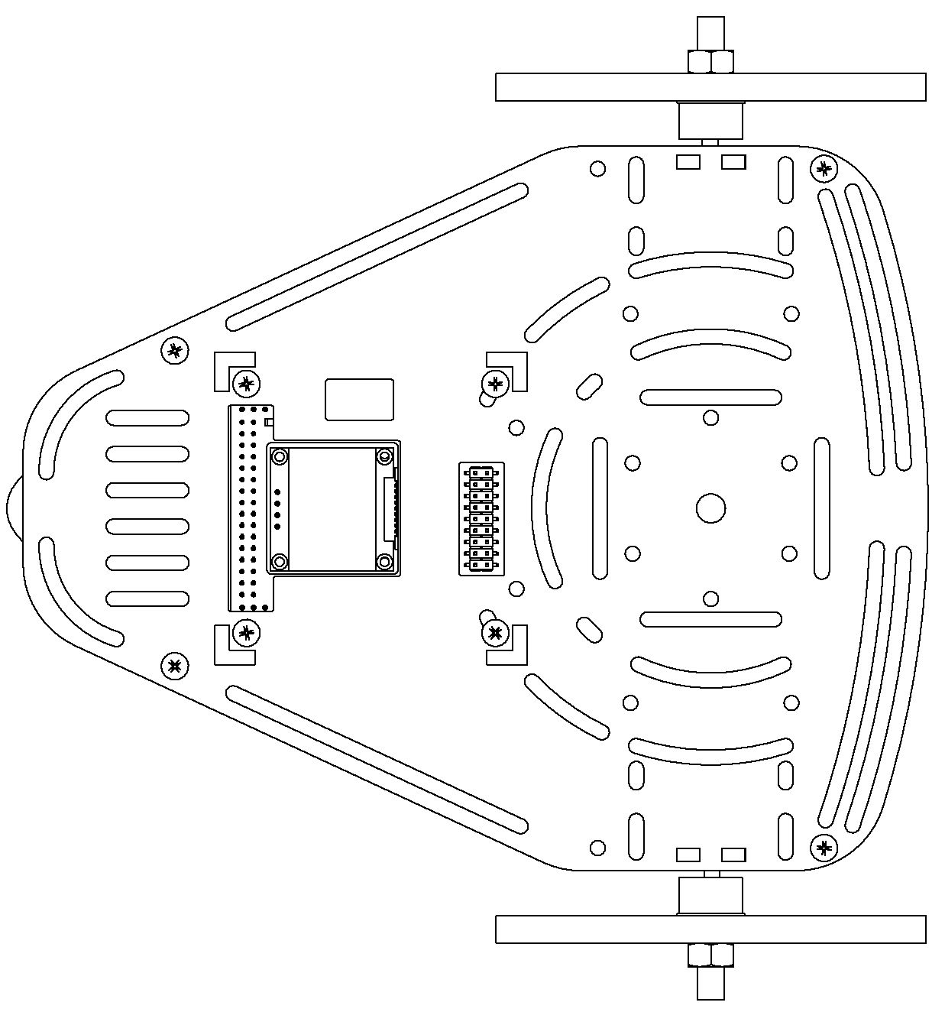
Activity Moving a real PuzzleBot
Straight line
Square
Drive the robot in a straight line.
Drive the robot making a square with a side length of 1m.

Slide 17
Activity SSH File transfer
You can directly add the jetson to you file System by following the next steps
Connect to the puzzlebot WiFi network
Go to files -> new location
Type ssh://puzzlebot@10.42.0.1 and introduce the password
Right click over the puzzlebot folder and select “add bookmark”
Now everytime you connect to the jetson network you´ll be able to acces files as they were in your computer.

Slide 18
Activity Moving a real PuzzleBot
Using ssh
Copy your “puzzlebot” package inside the folder catkin_ws In the jetson root directory
Run the node in the jeson using ssh.
Using ROS
Copy your “puzzlebot” package inside the folder catkin_ws In the jetson root directory
Stablish a ros wifi communication and run the node in your computer.

